Slide 1
EE 295
TechWriting-Engineering Ethics
Oct 9, 2019
Room BBC 004
Tom Wrappe
EE Lecturer

Slide 2
-Extra Credit Oppy
-Challenger Disaster- Virtue Ethics
-Midterm Draft
-Abstract and Exec Summary Review
-Checklist Review
Final Paper
Topic Draft
20 sources
Outline /Abstract
Final

Slide 3
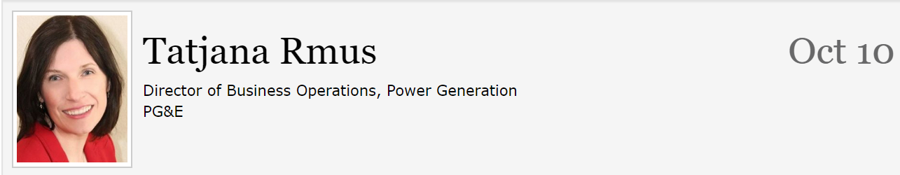
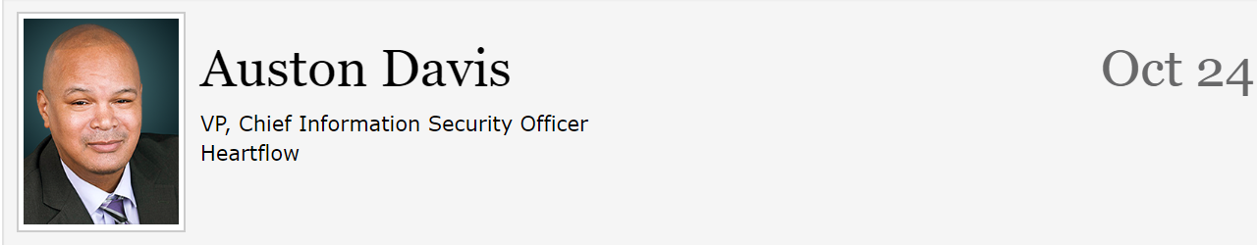
Issues and Reminders (Just a courtesy, not a requirement for lecturer to remind you)
Due date for Midterm Draft moved back to Oct 13@ 11:59pm from Oct 10 (Happy Midterms)
Extra Credit Opportunities remaining

Slide 4
Challenger Disaster
https://video.search.yahoo.com/yhs/search?fr=yhs-iba-1&hsimp=yhs-1&hspart=iba&p=Challenger+disaster+video+ethics+downloadable#id=1&vid=5069ea6bae6eb112a7ec648feb2090c5&action=click
Key area: 14:00 onwards
Background Facts:
-Launch originally scheduled for Jan 28, 1986, and was delayed 4 times due to multiple issues
-7 crew members all killed in explosion
-Root cause determined to be O-ring failure on the solid rocket booster build by Morton Thiokol
-Interview with Alan J MacDonald, Director Program Mgt at Morton

Slide 5
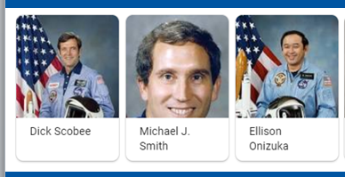
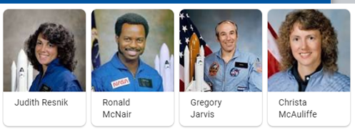

Slide 6
In Class Writing Exercise
Who displayed the lowest Virtue Ethics in the video of the Challenger Disaster (BE SPECIFIC—NOT “MANAGEMENT”)?
-> 300 Words
-Underline the topic sentences of each paragraph
-State your position clearly
-Support your assertion with facts
-Provide a strong conclusion
---------------------------------------------------------------------
Some Players in the Challenger Disaster:
-Director, Programs for Morton-Thiokol: Alan J MacDonald
-VP, Programs for MT: Joe Kilminster (Alan’s Boss)
-VP, Engineering MT
-General Manager, MT (Joe’s Boss)
-Nasa Director for Challenger Mission
-Objectivity, Honesty and Care combined with Phronesis

Slide 7
In Class Writing Exercise
Who displayed the lowest Virtue Ethics in the video of the Challenger Disaster?
-> 300 Words
-Underline the topic sentences of each paragraph
-State your position clearly (Summary)
-Support your assertion (Body)
-Provide a strong conclusion(Conclusion)
NO COMPUTERS and NO PHONE access to the INTERNET during the Exercise
Due at Class official end (5:45 pm or 8:45 pm)

Slide 8
Semester Major Items…..(subject to modification)
 | Mid Term | Resume | Final Paper | Final Presentation (slides )
Topic Paragraph | 9.5.19
Topic Proposed | 9.12.19 |  | 10.3.19
Topic Final | 9.19.19 |  | 10.10.19
Outline/ Abstract | 9.26.19 |  | 10.31.19
Research | 10.1.19 | 10.24.19 (Class) | 10.15.19
Draft Complete | 10.13.19 ** |  | 11.7.19 | 11.19.19
Final Submit | 10.22.19 | 11.14.19 | 11.26.19 | 12.3.19
Final Presentation | NA | NA | NA | 12.17.19 (Sect 1) 12.12.19 (Sect 2)

Slide 9
First 5 page Proposal A Concise version of a Business Plan
Outline | Outline/ Abstract | Draft (5 pages) | Midterm paper (5 pages) | Final Paper ? 15 pages
1. Abstract | Paragraph | ½ page max | ½ page max
2. Executive Summary | paragraph | ½ to 1 page | ½ to 1 page
3. Product Description | 2 paragraphs or so | 1-3 pages
4 Mkt Research and Analysis | 1-2 paragraphs (5 sources min) | 1-3 pages | Depends on sources
5. Finance and Economics | Short paragraph | ½ to 1 page
6. Management Team | Short paragraph | ½ page
7. Risks and Assumptions | Short paragraph | ½ page
8. Conclusions and Recommendations | Short paragraph | ¼ to ½ page
A. Sources | Not Applicable | ½ to 1 page | ½ to 1 page
The outline endures while the content grows

Slide 10
Midterm: First Draft
A first complete paper with all the elements in the outline in the right proportions
Structurally in the final form
Topic Sentences have final content, but may be “tightend up in final”
Read topic sentences of Draft and get the flow of the paper
Set up for success, but not “polished”
Abstract, Executive Summary, Conclusion are finalized last, after the Body of the paper
Body (Product Proposal and Market/product research are complete in content, but not necessarily as concise as the final)
Draft likely longer than Final
Add conciseness: Reduce wordiness/filler, remove/rewrite words to make simpler

Slide 11
Midterm: Content Checklist
Item | CHECKLIST ITEM
[a] | Abstract: Motivation Sentence
[b] | Abstract: Problem Statement
[c] | Abstract: Results Sentence
[d] | Abstract: Conclusions Sentence
[e] | Abstract: Keywords
[f] | Executive Summary: Proposal Background
[g] | Executive Summary: Problem Statement
[h] | Executive Summary: Financial statement related to the proposal
[i] | Executive Summary: Recommended action for “boss”
[j] | Product Description: Product Description (underline all sentences that apply)
[k] | Product Description: Product Differentiators (what is “special” about the proposed product?
[l] | Conclusion: Recommendation Statement

Slide 12
Midterm: Grammar Items Checklist
It | Description | Checklist Item (to be contained in table at end of the paper)
1 | NO PERSONAL PRONOUNS | Confirm no use of “I, we, me, mine, our, ours, let’s, us, you, your, he, she
2 | No use of “Very” | Confirm no instance of “very”
3 | Avoid Passive Voice | Confirm no passive voice
4 | All paragraphs have at least three sentences | Confirm

Slide 13
Abstract Checklist
Motivation
Why do we care to make this paper?
Goes first if the problem is NOT OBVIOUS, otherwise Problem Statement first
Problem Statement
What problem are you trying to solve?
What is the scope of your paper—specific solution (Product) or a general study of a tech area (Research)
Approach
How did you go about solving or making progress on the problem?
What was the extent of your work?
How far did you go to explore the options
Results
What was your answer?
How was your approach better than other potential approaches?
Faster, Cheaper, smaller, more precise?
Go for concise answers rather than vagueness
Conclusions
What are the implications of your answer?
Is it going to change the world, be a nice hack or simply serve that this approach is not the way to go?
Are your results applicable only to your issue or across a large spectrum of problems/ opportunities

Slide 14
Autonomous Vehicle Navigation
ABSTRACT— [a] This paper describes a system that navigates the vehicle autonomously. Autonomous vehicle navigation has gained increasing importance in modern transportation systems. [b]In non-urban domains such as deserts, the problem of successful GPS-based navigation appears to be almost solved while navigation in urban domains, particularly in the close vicinity of buildings in dense urban environments, is still a challenging problem. In such situations GPS accuracy significantly drops down due to the impaired GPS signal. [c]This system provides a communication between the vehicle and the internet using a GPRS modem. This navigation system is interfaced with OSRM open source map data through internet. To improve precision of navigation, this system uses location information from inertial sensors to complement basic GPS. The system also uses a rotatable laser range finder for obstacle sensing. This is an internet-connected system that can provide full information to a remote observer. [d]The autonomous vehicle navigation system has broad applications for self driving vehicles due to the higher navigation quality in key urban areas.
[e] KEYWORDS— GPS, GPRS, compass, navigation, localization, inertial, laser

Slide 15
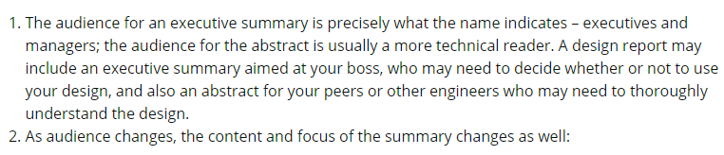
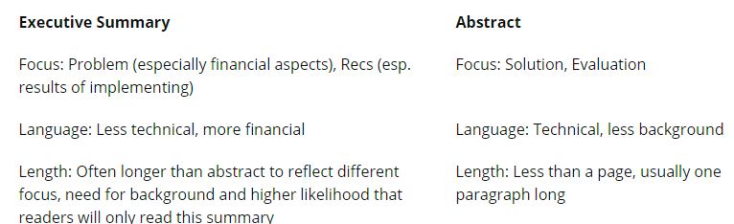
Executive Summary vs Abstract Audience Matters
[g]
[h]
[i]
[c]
[b]

Slide 16
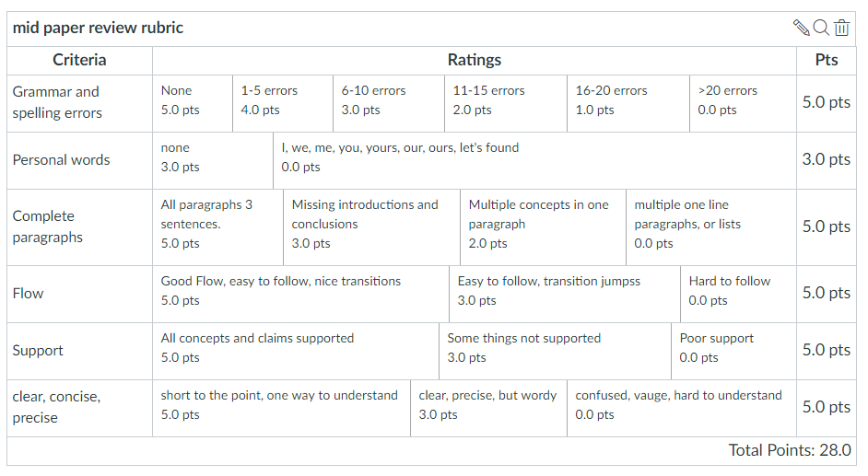
Midterm Paper Rubric

Slide 17
Class Exercise Oct 15, 2019
For Oct 15 (after you submit draft of Midterm due Oct 13)
Bring a printout of your Abstract, Executive Summary and Conclusion paragraph (s) to class to exchange with team members
Inputs will help craft the final versions of these important paragraphs due Oct 22
Discussion should assist your inputs on Peer Review

Slide 18
Final Report Topics
The last 10 pages can be a continuation of the Proposal IF you are taking EE297 or EE299. This 15 page Proposal will then be used as a Proposal for your Project.
or
If you are not planning on taking EE297 or EE299 the last 10 pages can be a Research Report.
The SPECIFIC Topic should be submitted for approval (selected topics will be presented to the class)

Slide 19
Final Research Report Options
Propose a term paper topic. This topic could be research and results you wish to study, a masters project research proposal, a business plan for a new product (that expands on the Midterm).
Write a >600-word proposal (1-2 page), submit on Canvas.
Submit via Turnitin and achieve <15% Plagiarism score

Slide 20
Final Paper Topics Overview
--Some things to consider
+Project will require at least two “features” (diagrams and/or tables) with references in the text.
-Use IEEE standards for tables and figures
+Structure is the key--think about the structure of your final paper (Use the structure of the Midterm if you are expanding)
+Make the main subject prominent (do not “bury” in the technology area)
+Substantial research (at least 20 sources)
+Who is your audience? (if you are doing research rather than continuing a proposal for “your boss”)?

Slide 21
First 5 page Proposal A Concise version of a Business Plan
Outline | Outline/ Abstract | Draft (5 pages) | Midterm paper (5 pages) | Final Paper ? 15 pages
1. Abstract | Paragraph | ½ page max | ½ page max
2. Executive Summary | paragraph | ½ to 1 page | ½ to 1 page
3. Product Description | 2 paragraphs or so | 1-3 pages
4 Mkt Research and Analysis | 1-2 paragraphs (5 sources min) | 1-3 pages | Depends on sources
5. Finance and Economics | Short paragraph | ½ to 1 page
6. Management Team | Short paragraph | ½ page
7. Risks and Assumptions | Short paragraph | ½ page
8. Conclusions and Recommendations | Short paragraph | ¼ to ½ page
A. Sources | Not Applicable | ½ to 1 page | ½ to 1 page
The outline endures while the content grows

Slide 22
Framework for Research Option #2
Area of Research
The “container” is the Analysis Process you choose:
-Compare multiple technologies by measuring their performance in a consistent “test” process (Comparative Analysis)
-Measure a single technology’s ability to perform a previously unachievable “test” (Feasibility Study)
Specific Topic
(Describe Specific Research
Research is a fluid.
It has the form of the container you choose.
Criteria for Analysis
ANALYSIS
Results and Implications
Conclusions &Recommendations

Slide 23
Research Challenges
A research paper is more than simply a technical description to explain a complicated technology to others
Requires a level of understanding of the underlying tech as well as its ability to provide value
Research paper requires more custom work than a product paper
Audience is experts in the field of the research topic
Requires more background than product
Measurement of success for product is market success while the author must define success for research upfront
The Flow of a proposed research process is different for different topics
AI applied to network security different from AI applied to machine inspection of parts
Elements are similar, but the author must construct an outline for research that matches the flow of the research itself rather than leverage existing product outline

